Slide 1
NLP Overview–covid-19 relevancy
Rajesh Jeyapaul,Sr. Developer Architect ,IBM
LinkedIN / Youtube - rajeshjeyapaul

Slide 2
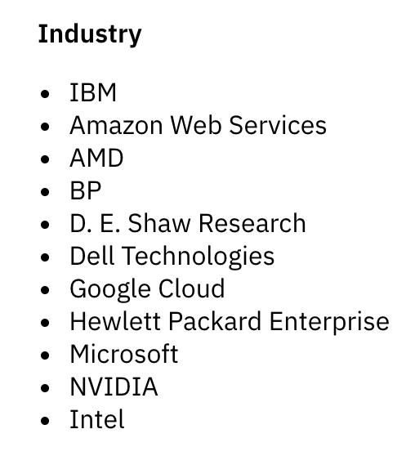

Role of Industry
Fighting COVID-19 will require extensive research in areas like bioinformatics, epidemiology, and molecular modeling
High Performance Computing (HPC)
Bringing together the Federal government, industry, and academic leaders to provide access to the world’s most powerful high-performance computing resources in support of COVID-19 research.
White House Office of Science and Technology Policy, the U.S. Department of Energy and IBM
https://covid19-hpc-consortium.org/

Slide 3
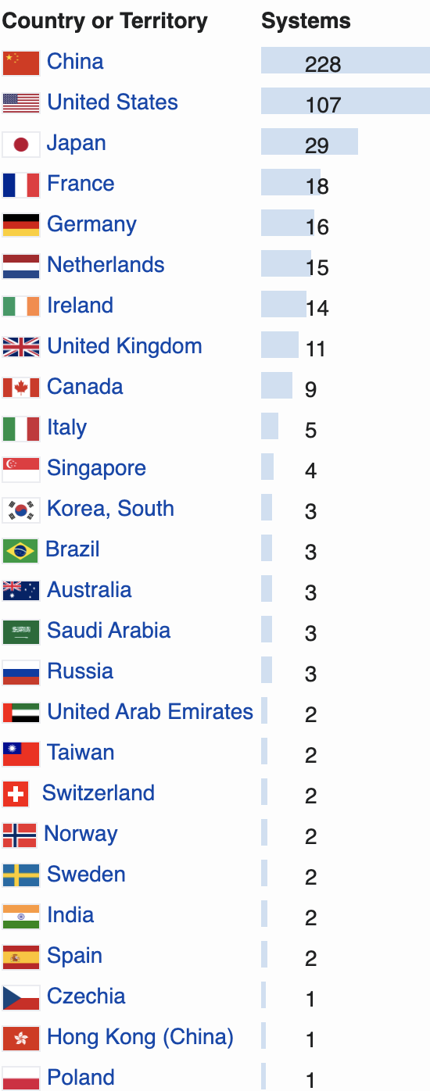
HPC Resources and Projects
109K Nodes
4M CPU cores
41K GPU
429 Petaflops
Pratyush and Mihir – Supercomputers in India with 6.8 Petaflops (as of Jan 2018)
Dedicated for Weather and Climate research
4th in the World (Japan, US & UK)
Notes:
https://en.wikipedia.org/wiki/TOP500

Slide 4
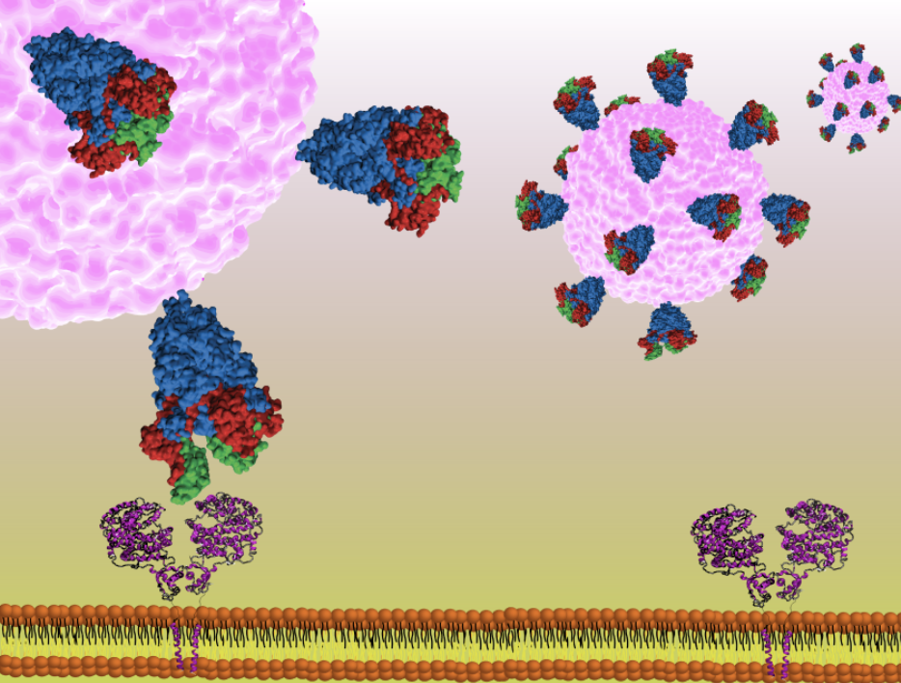
Projects
Understanding how coronavirus spike glycoproteins undergo conformational changes to bind to host ACE2 receptors is key to the development of coronavirus vaccines and therapeutics, which requires a dynamic rather than a static picture to provide a reliable structure-based drug design framework.
Focus on two underexplored proteins, NSP9 (involved in RNA processing) and E protein (a viroporin). Find a compound that binds with NSP9,which halts viral replication
AI-driven identification of potential compounds by IBM to enable and accelerate identification of compounds which could be repurposed as candidate anti-viral drugs.

Slide 5
Projects
Develop a device to allow safe ventilator splitting between 2 or more patients.
Indian medicinal herbs have phytoconstituents that may show great promise as anti-CoVID19 drugs.
Screen phytochemicals for anti-CoVID19 activity
Implementation Approach:
extensive literature analysis to confirm anti-viral activity of chosen phytoconstituents, Druggability analysis, Molecular docking preparation (ligand and target) and execution and confirmation through advanced in silico methods.
Shoolini University

Slide 6
Projects
Privacy aware Contact Tracing
Alert people who may have been in close contact with an infected patient
After a case is diagnosed, those who were exposed with the infected patient can easily be tracked back and analysed.
Does not expose personal information. Does not rely on sensitive data based on geolocalisation
data exchanged by the Bluetooth LE (secret) handshaking protocol of our smartphones
does not allow people to locate infected patients.
In order to prevent tracking of a certain device by its MAC address, BLE supports randomized MAC addresses. The MAC address in the transmitted packets changes over time
Aarogya Sethu from India

Slide 7
Dialog System - Watson Assistant
ICMR to Leverage IBM Watson Assistant
Queries will be categorized under various headings such as Governance, Logistics, Data entry and sharing, Staff Training & Testing and for complex questions, pre-defined contact information of ICMR is made available.
Type of Queries:
nature and process of data to be captured by test labs
how to record inventory of test kits & reagents
reporting to various Government agencies
references to the latest guidance
queries on COVID-19 in general.
help in on-boarding new data entry operators and staff of diagnostic centres
Watson Assistant User for Covid- University of Arkansas for Medical Sciences; County of Otsego in New York; the City of Austin in Texas; the UK National Health Service Wales; and the Polish Ministry of Health and many other organizations across countries
Notes:
http://www.smechannels.com/icmr-to-leverage-ibm-watson-assistant/

Slide 8
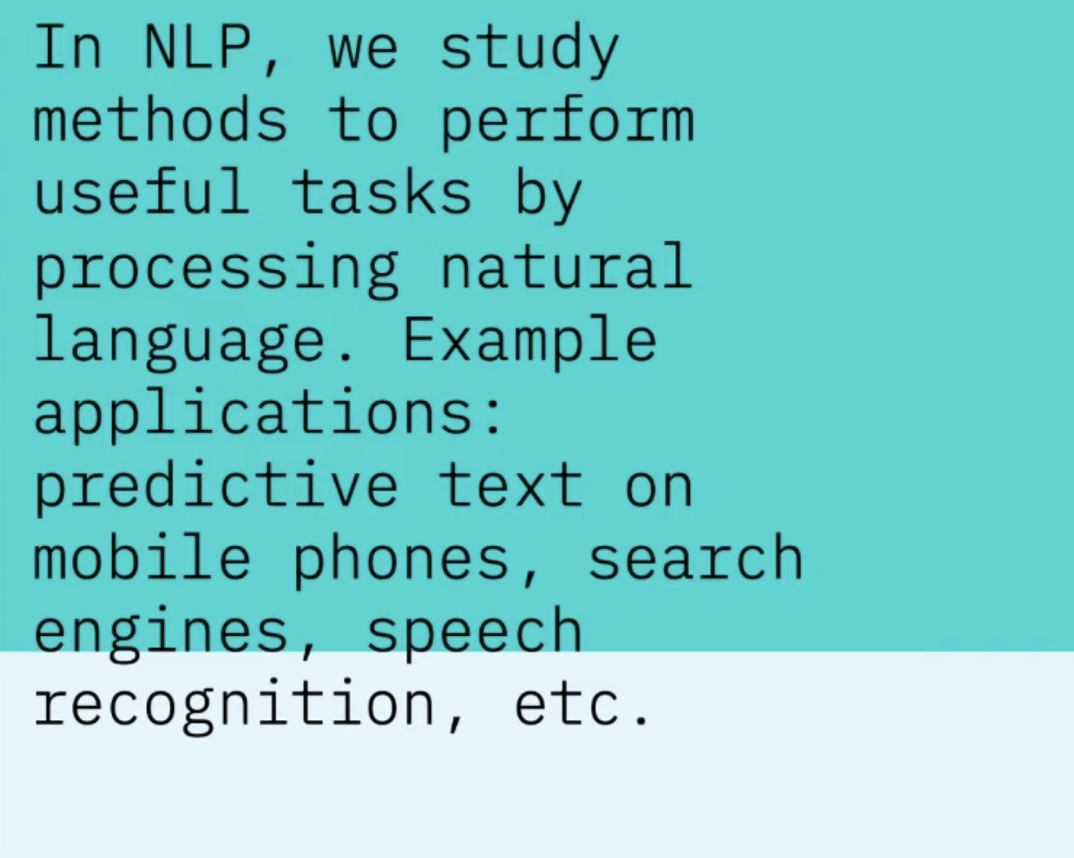
NLP

Slide 9
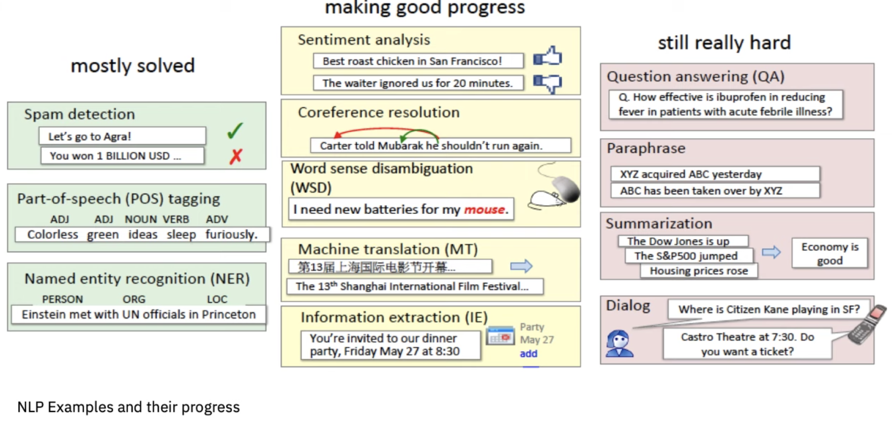

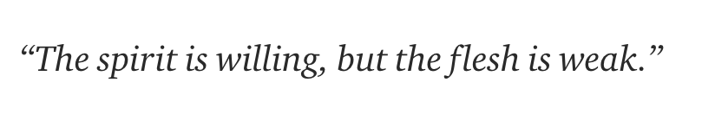
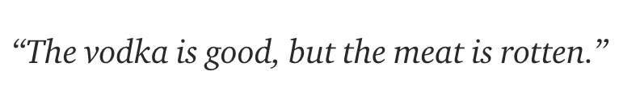
NLP Examples
En to Ru to En

Slide 10
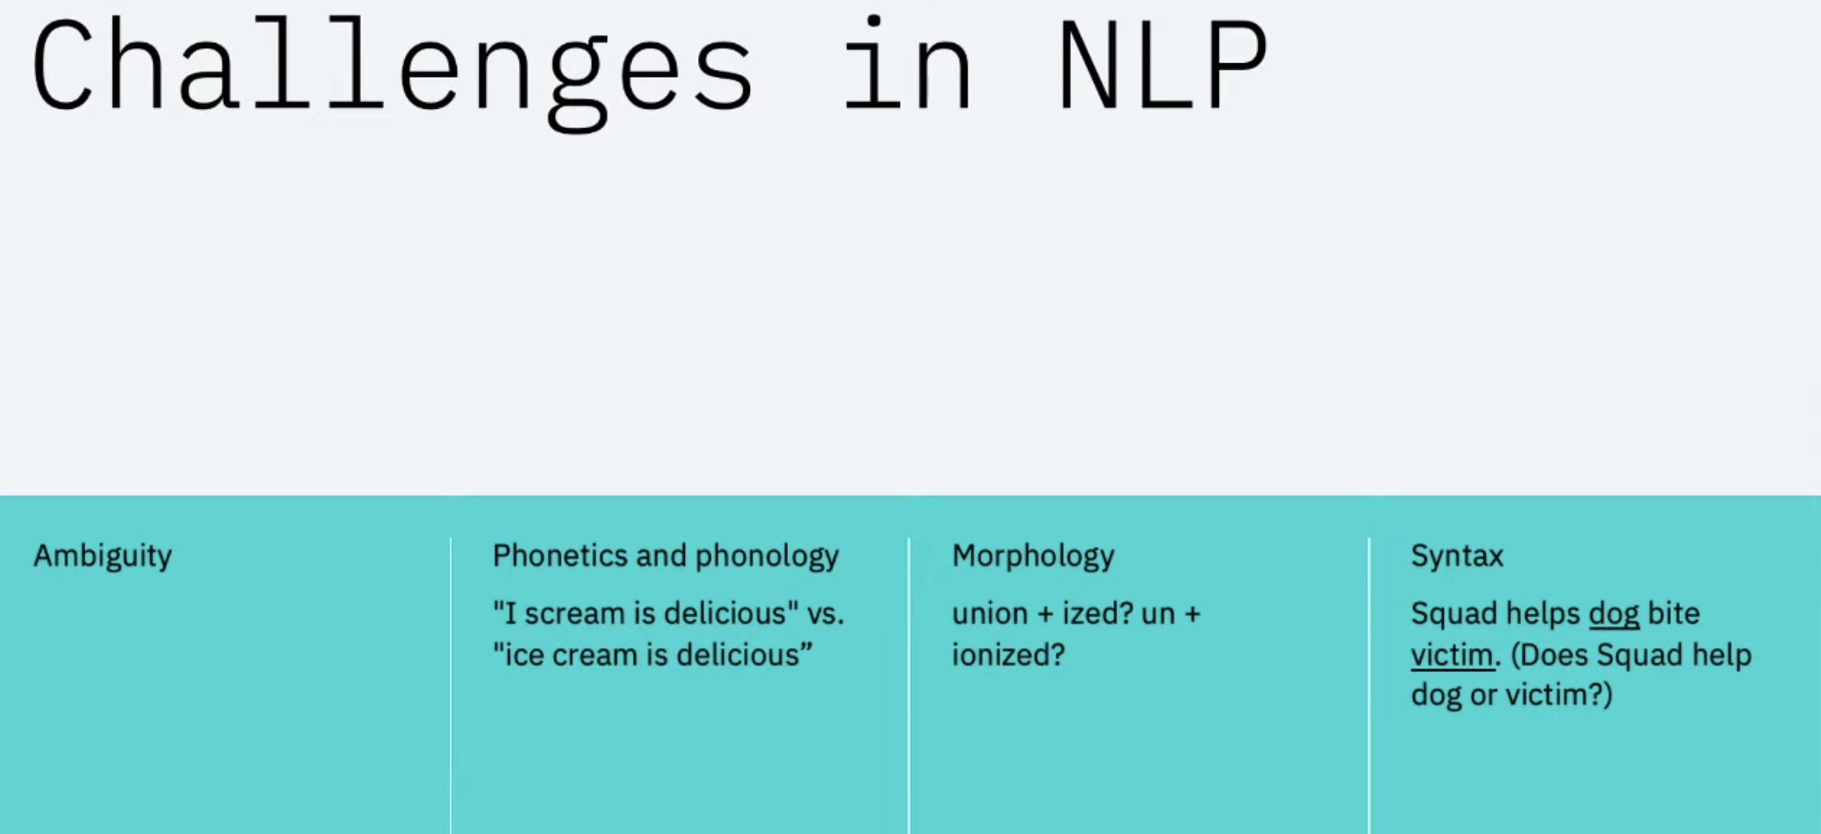
Notes:
https://developer.ibm.com/videos/an-introduction-to-natural-language-processing-webcast/

Slide 11
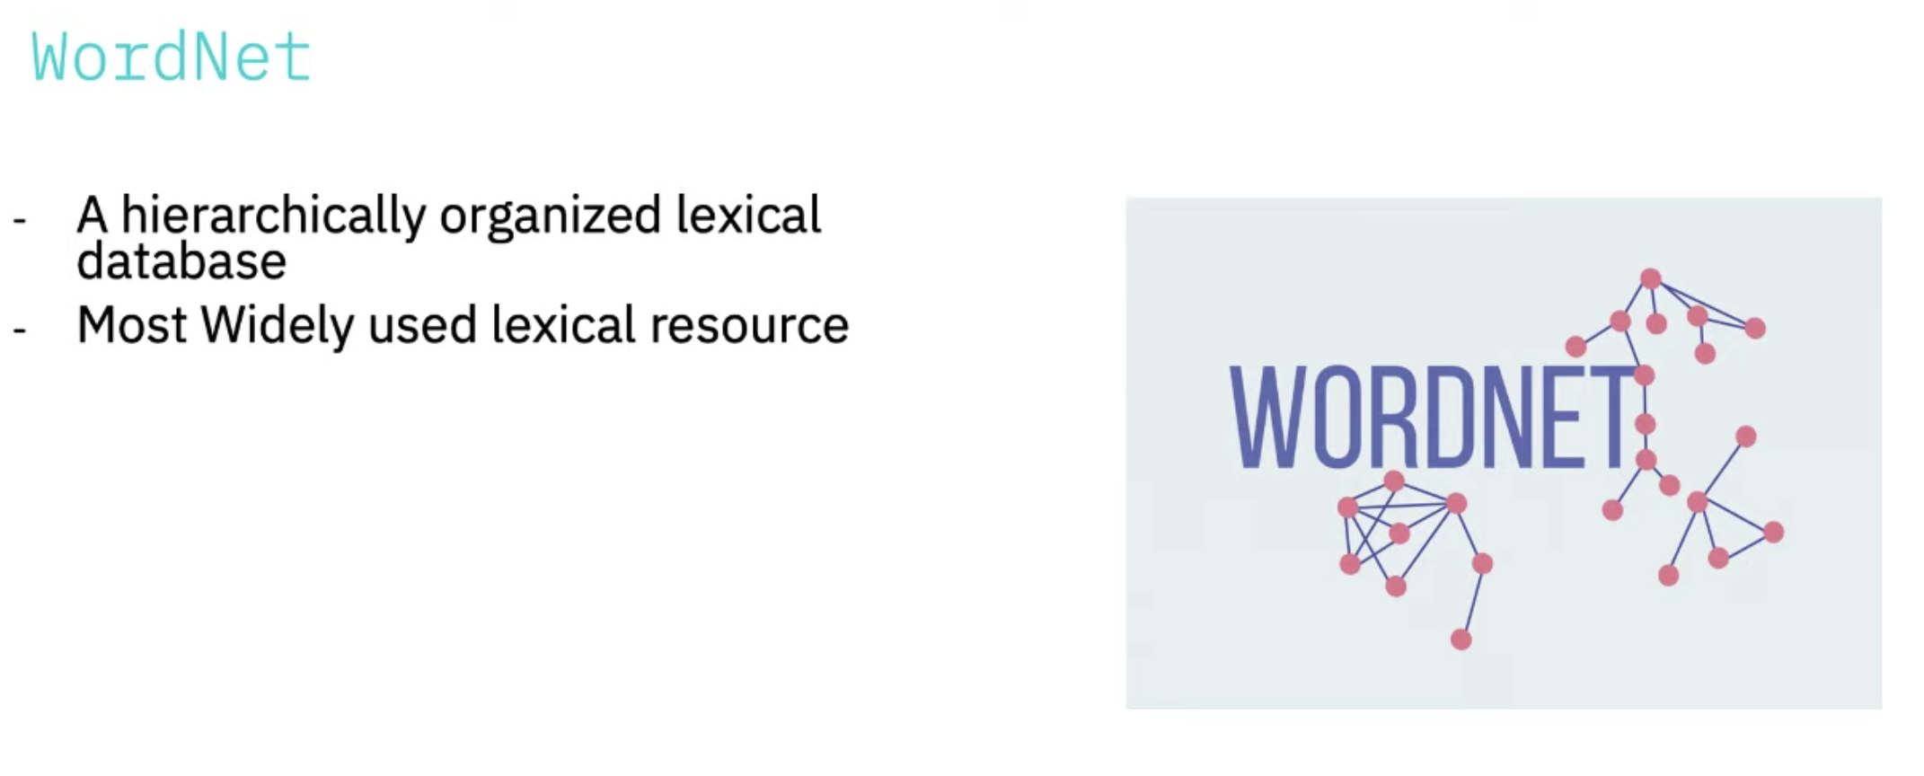

Slide 12
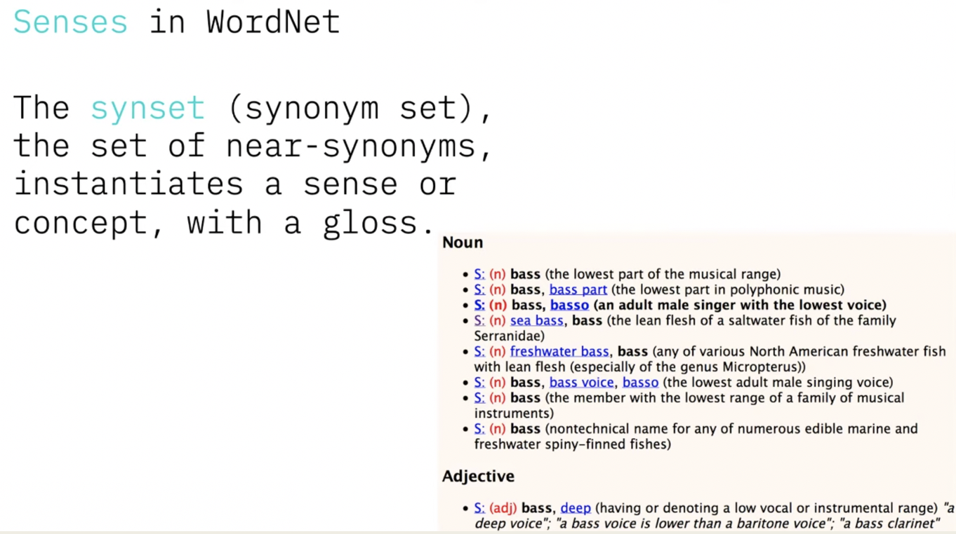

Slide 13
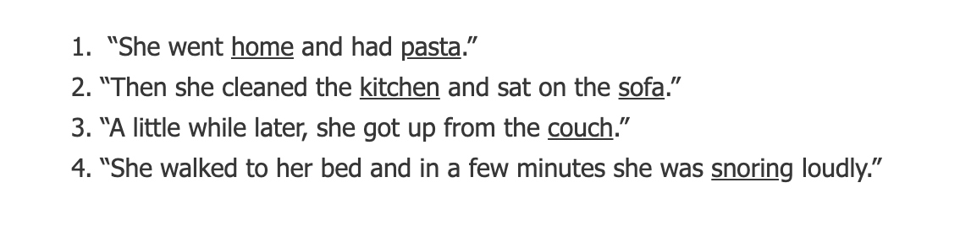
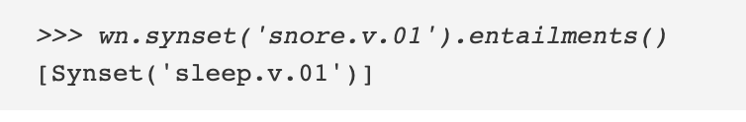
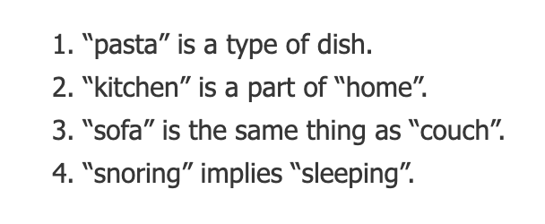
NLTK - Platform to build python program to work with human data

Slide 14
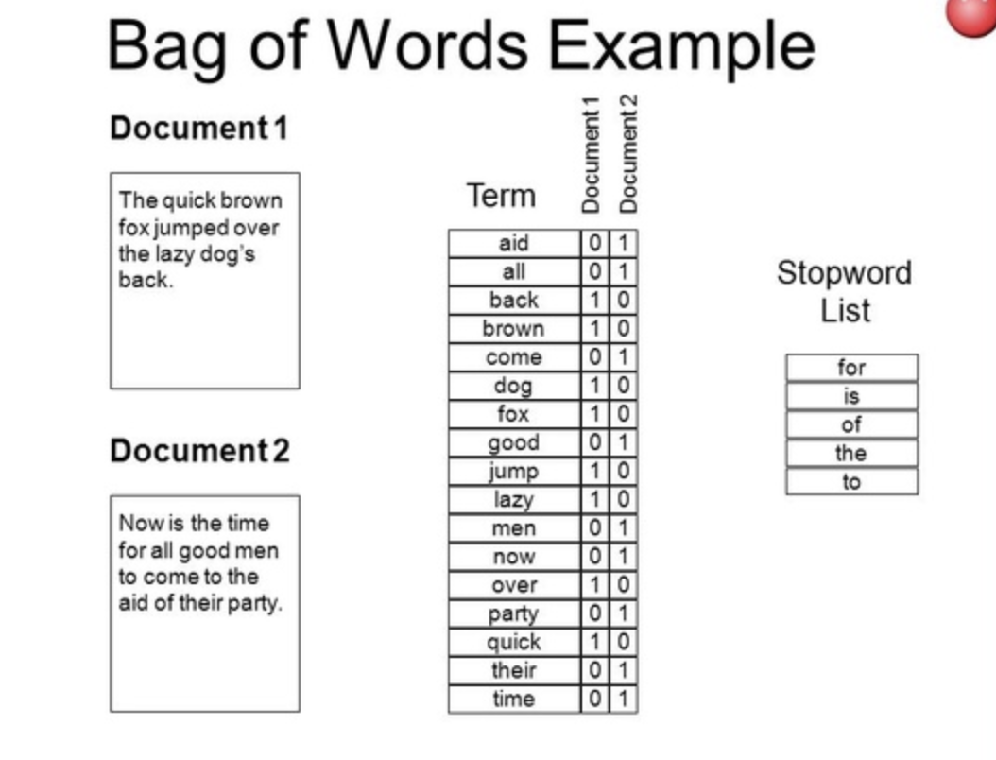
Bag of Words (BOW)

Slide 15
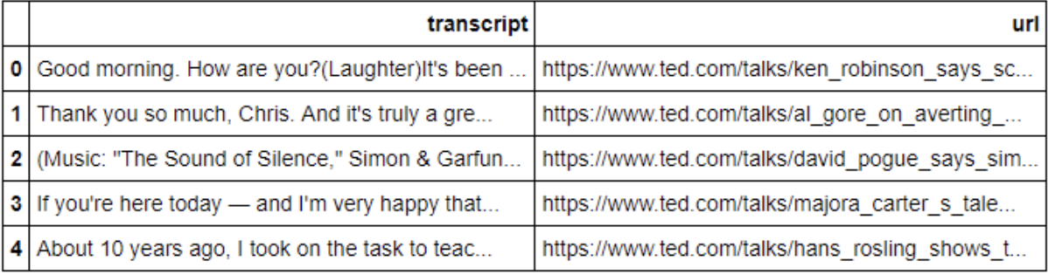
Recommendation system and NLP
Ted Talk Recommendation
Data:
Create a Vector Representation of transcript against the corpus (all transcript)
Frequency of words but not the importance of words considered
How frequent * How rare in the Corpus -> Importance of words
TF-IDF (Term Frequency –Inverse Document Frequency)
Cosine Similarity Matrix – How each document is similar to other
That’s it…
Take any Ted talk title and recommend top ”N” similar titles..

Slide 16
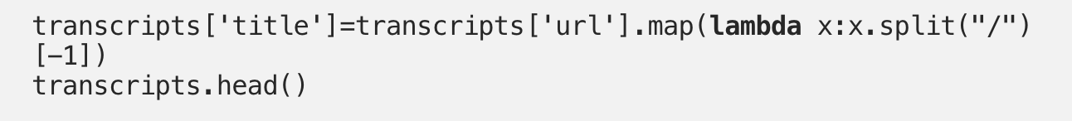
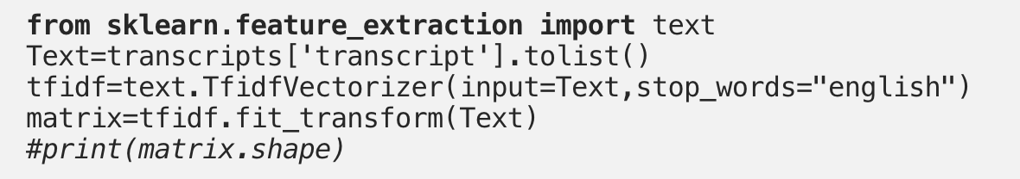
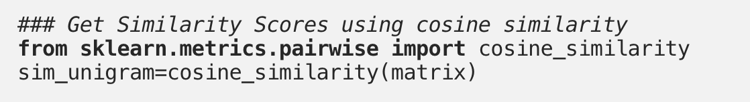
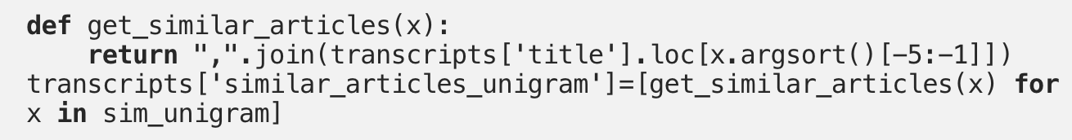
Implementation –( scikit-Learn )
Read the transcript
Create TF-IDF vector
Get Cosine similarity
Recommend…

Slide 17
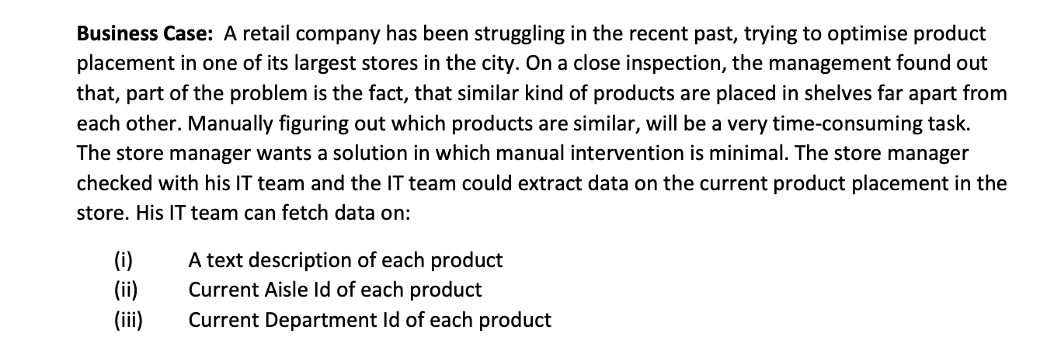
Problem statement – Try it out..
Data to be made available on request..

Slide 18
Demo video…available @ https://drive.google.com/open?id=1NtwM9isr_cPBWWdvOYSkVRe9N5yIzke8
Demo – Natural Language Undersanding
Provisioning Watson Assistant
Building a short tail FAQ – Role of DBS Solution Architect, using Watson Assistant

Slide 19
NLG (Natural Language Generation )
Produce Written or spoken narrative from a dataset
Example, From the pollution level across cities to written description about the state of pollution level
Automated Journalism – search the web , retrieve the data and write a text summary which can be published
Can be integrated with the chatbot to product text information from the data

Slide 20
Further Exploration..
Cognitiveclass.ai
Digital Badges
Free
Code Pattern
https://developer.ibm.com/patterns
Sample implementation code – github repo
Architecture diagram
Youtube explanation
IBM , Third party and open source technology components

Slide 21
Thank you …

